Slide 1
Update on State Testing-CAASPP and ELPAC update
March 30, 2021

Slide 2
2020-2021 ELA, Math, and Science State Tests
State Board of Education and CDE Guidance
5th, 8th and High School: Science test waived for 20-21
For ELA and Math: Use the “most viable option for assessment in their local context”
Aligned to CA state curriculum standards
Results are reported to parents/guardians, educators, and to the public
Decouple state assessments from federal accountability requirements
Waive federal penalties for student testing participation rates of less than 95 percent
Notes:
The US Department of Education still needs to approve California's proposal. It has been approved by the State Board of Education and the California Department of Education.

Slide 3
Recommendation
to the Board
Use Fastbridge ( ELA and math assessment tool) in lieu of the Smarter Balanced - grade 3-8, 11
11th Grade Option in addition to taking Fastbridge:
Students can opt-in to take the Smarter Balanced exam if they are interested in the early assessment program (EAP) used by CSU and UC
Note: EAP is not used for UC or CSU admission purposes, but for placement into the appropriate ELA and math course
Special Education will take the California Alternative Assessment (CAA) if it is noted in the IEP
English Learner Students Continue testing the with ELPAC summative testing, K-11.
Important part of the reclassify English proficient (RFEP) process
Based on school site stakeholder feedback and state guidance
Notes:
The US Department of Education still needs to approve California's proposal. It has been approved by the State Board of Education and the California Department of Education.

Slide 4
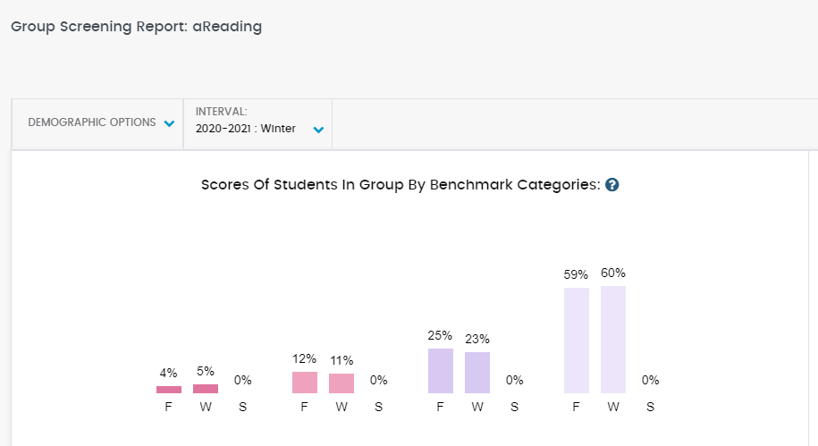
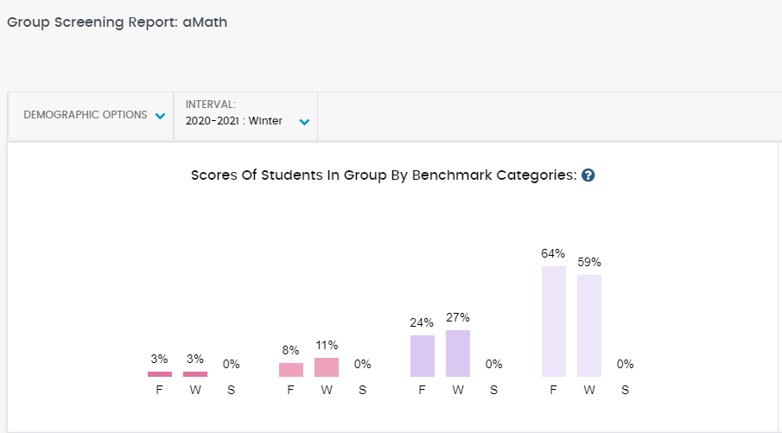
What Fastbridge will tell us - District Level
Part of a multiple measurement system
Notes:
The US Department of Education still needs to approve California's proposal. It has been approved by the State Board of Education and the California Department of Education.

Slide 5
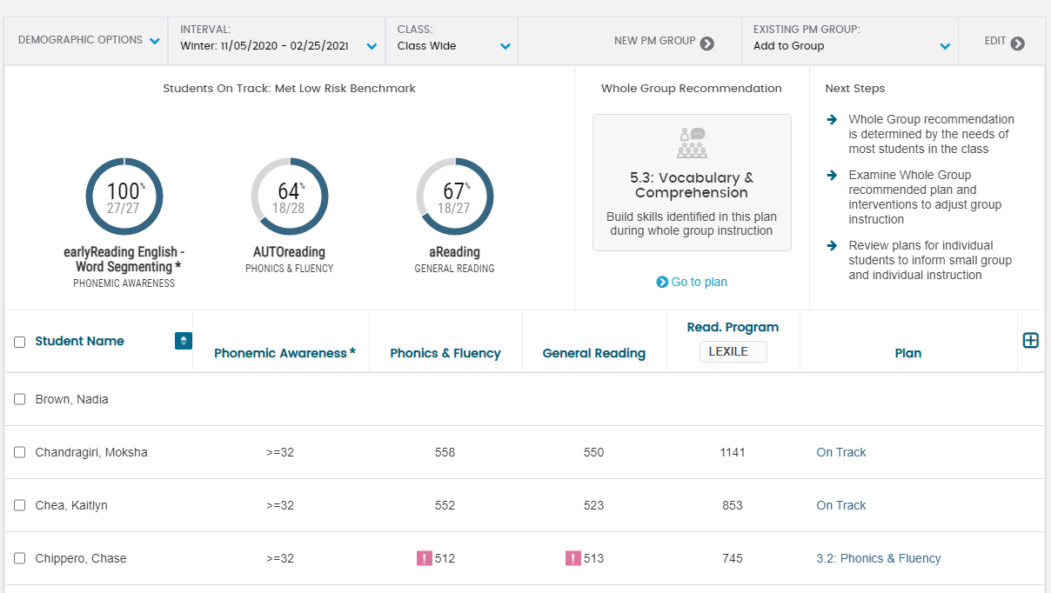
?
What Fastbridge will tell us - ELA by student :
.
Notes:
The US Department of Education still needs to approve California's proposal. It has been approved by the State Board of Education and the California Department of Education.

Slide 6
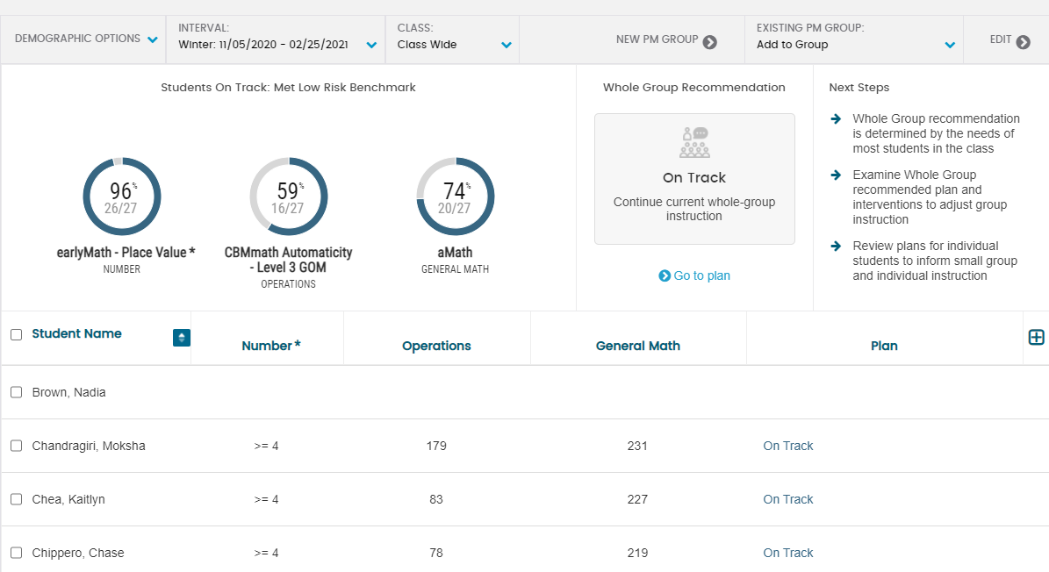
?
What Fastbridge will tell us - Math by student:
.
Notes:
The US Department of Education still needs to approve California's proposal. It has been approved by the State Board of Education and the California Department of Education.

Slide 7
Fastbridge Spring Assessment
May
Optional 11th Grade SBAC
May
February 24 and March 16
State Board and CDE Guidance
ELPAC Summative
Ongoing
Timeline

